Slide 1
Introduction to Data Science
Notes:
For in-person training, cover instructor and student introductions if appropriate

Slide 2

Introduction to Data Science
your lecturer: Nhan Tran
nhan.th@aptechlearning.edu.vn
I'm Data & AI Expert at One Mount
Former Head of Customer Insights and Data Management at Lazada;
Lecturer at Aptech Computer Education, and FTU Hanoi;
Committee Member of The International Society of Data Scientists;
Official Editor at Towards Data Science.

Slide 3
Objectives
Introduction to Data Science
Introduction to Data Analysis
Data Science processes
AI vs ML vs DL
Fallacies

Slide 4
1a. Data Science
Computer
Science
Mathematics
Statistics
Domain
Knowledge

Slide 5





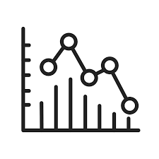


1b. Data Ecosystem
Data Sources
ENTERPRISE DATA ENVIRONMENT
User Interfaces
Data integrated from disparate sources
Different types of analysis and skills to generate insights
Active stakeholders to collaborate and act on insights generated
Tools, applications, and infrastructure to store, process, and disseminate data as required
Notes:
Introduce the "Data Ecosystem" which has 3 basic tiers: Data Sources -> Data Environment -> User Interfaces
Enterprise Data Environment is the middle layer and we will focus on it
Data Sources include files, images, videos, everything separated
Data sources can be collected from outside, and generated from inside app
User Interfaces are the way normal people "see" from data
Enterprise Data Environment is the whole process Data Team do, from Data Sources, to User Interfaces, including (slide)
Let's discuss about Data Sources

Slide 6



1c. Enterprise Data Environment technologies
Cloud Technologies
Machine Learning
Big Data
Notes:
Introduction: Cloud, Machine Learning, Big Data
These emerging technologies shaping the modern data ecosystem:
Every enterprise today as access to limitless storage, high performance computing, open source technologies, machine learning technologies, and latest tools and libraries
Data Scientist are creating predictive models by training machine learning algorithms on historical data
Big Data is paving the way for new tools and techniques, and also new knowledge and insights

Slide 7




1d. The Purpose of Data Ecosystem
Fraud Detection
Recommendation Engines
Data Mining
Customer Insights
Notes:
Today, organizations are using data to uncover opportunities and applying that knowledge to differentiate themselves from their competition by:
Identifying patterns in financial data to detect fraud
Using recommendation engines to drive conversion
Mining social media post for customer voice
Analyzing customer behavior for personalizing offers
To get value from data, you need a vast number of skill sets and people playing different roles. Let's explore those roles

Slide 8


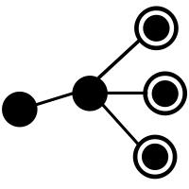
2a. Data Analysis Introduction
Data Analysis helps business:
Understand the historical data (their performance);
Validate course of action: save times, resources, ensure success;
Take informed decisions.
Descriptive Analytics
Diagnostic Analytics
Predictive Analytics
Prescriptive Analytics
"What happened?"
"Why did it happen?"
"What will happen?"
"What should be done?"

Slide 9


2b. Introduction to Data Analyst
The role of Data Analyst depends on type of your company, and the extent to which it has adapted data-driven practices
Acquiring data;
Creating queries to extract required data;
Filtering, cleaning, standardizing, and reorganizing data;
Using statistical tools, and techniques;
Analyzing patterns;
Making charts, and reports;
Creating appropriate documentation
Your company
Your team's practices
Notes:
The role of Data Analyst depends on type of your company, and the extent to which it has adapted data-driven practices

Slide 10
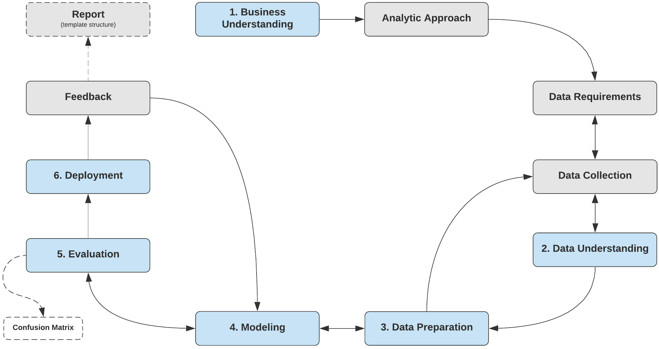
3. The Data Science processes
"Data science is an inter-disciplinary field that uses scientific methods, processes, algorithms and systems to extract knowledge and insights from many structural and unstructured data. Data science is related to data mining, machine learning and big data" ^{(Wikipedia)}
Machine Learning
Footnote: source on Lucid Chart

Slide 11
4. AI vs ML vs DL
ARTIFICIAL INTELLIGENCE
A program that can sense, reason, act, and adapt
Artificial Intelligence (AI) is a discipline
MACHINE LEARNING
Algorithms whose performance improve as they are exposed to more data over time
Machine Learning (ML) is a specific way of solving AI problems
DEEP LEARNING
Subset of machine learning in which multilayered neural networks learn from vast amounts of data
Deep Learning (DL) is used when you can't explain the labeling rules
Pitfall: do not misunderstanding Artificial Intelligence and Software Engineering

Slide 12
5a. Machine Learning fallacy
dead mindset #1: “in machine learning, we only use data and algorithms”
in reality, machine learning is the combination of:
programming skills (mostly Python, then R, MATLAB, C/C++, Java)
analytics skills, including mathematics and statistics, hypotheses testing, and visualization
engineering skills to retrieve data, and put your models to production
business understanding

Slide 13
5b. Data Scientist fallacy
dead mindset #2: “Data Scientist job is to build machine learning models”

Slide 14


